Slide 1

OSS: Open Source Security
Daniel Charles, Thomas Stinton, Jason Hoare, Ethan Barrett
Notes:
-Introduce in order of presentation

Slide 2
Overview of Project
A security system for houses and small buildings
Nodes to secure small boxes (e.g. jewelry) and improve safes
”Control Node” for human interface
Mesh communication node for inter-node data transfer
Notes:
Tom Slide:
This project aims to provide a cheap, effective distributed system used for improving security in homes. Multiple methods of communications (both wired and wireless) create a distributed system, and password requirements provide information security.

Slide 3
Middleware
Middleware for all nodes
Allows wireless communication for a distributed system
Addresses automatically generated from the CHIPSET MAC ADDRESS
Showcase of node packet information
Notes:
Ethan Slide:
The middleware is used on all the nodes, and is a mechanism for sending and receiving information from other nodes.

Slide 4
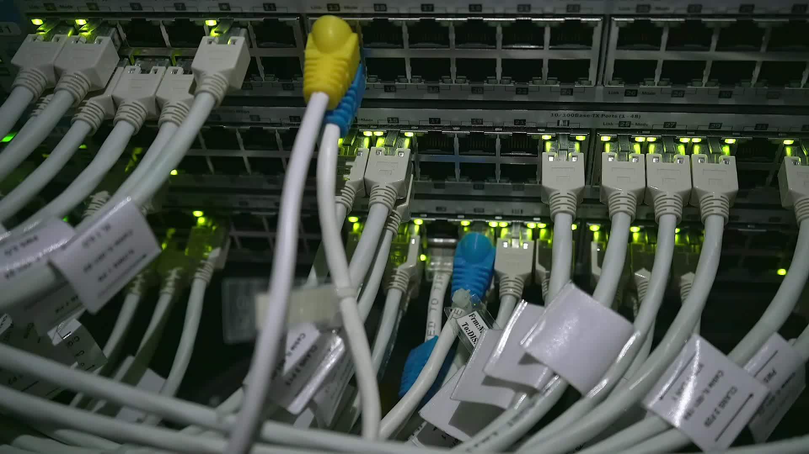
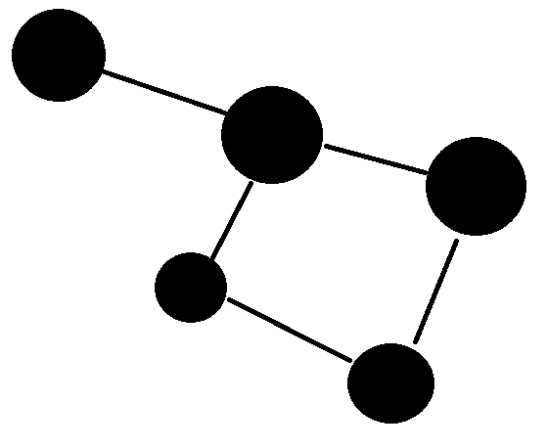
Middleware Continued [what is a mesh]
Automatic Receiving of commands
Nearest Neighbour mechanism
Allows for simultaneous data transmission and receiving

Slide 5
Node 1 - Control
Allows for human interaction
Comprised of Keypad, Alarm, LCD, Arduino Uno and ESP8266
UART, TCP/IP and I2C
Password and menu
Notes:
Dan Slide:
This node is the human interaction node, meaning it allows human input to interact with the system. Features include locking/unlocking the system, alarm testing, and help page.
The system uses an LCD to visualize the system functions available.
The system is built on an Arduino, with UART connection to the ESP board for communication.

Slide 6
Node 2 - Safe
Electronically improves safe security
Comprised of Ultrasonic Sensor, Sound Trigger and ESP8266
GPIO and TCP/IP
Adjustable Thresholds
Notes:
Tom Slide:
This node is designed to improve the security of a safe the user owns.
The node will be suspended from the top of the safe at a specified distance from the closed safe door.
When Armed the sensors will send regular readings to the ESP via GPIO (both digital and analogue) and Serial communications, and when triggered, the ESP sends an alert via the mesh network (which is TCP/IP).
Thresholds for triggering can be adjusted internally to suit a wide range of safes and environments.

Slide 7
Node 3 – Valuables Box
Provides security for small boxes containing valuables
Comprised of Inertial Measurement Unit (IMU) and ESP8266
I2C and TCP/IP
Rolling Average for reducing outlier impact
Notes:
Jason Slide:
This node is a small system designed to be hidden within a jewelry box, and detect movements of the box. This is done by combining Gyroscope and Accelerometer readings within an IMU to measure changes in position and orientation of the system (and therefore the box). The output is generated by using a rolling average of the 10 most recent readings, and if a large change is measured in a small time, it is assumed the box is moving, so an alarm is broadcasted. The IMU and ESP communicated using I2C, and the alarm is broadcasted over the mesh network using TCP/IP.

Slide 8
Integration
MESH Architecture
Heterogenous system
TCP/IP, UART, I2C, and GPIO
Error Codes
Notes:
Ethan and Dan Slide:

Slide 9

Testing
Found that it has a range of over 10m
Found that it can auto connect/reconnect the system

Slide 10
Demo Time
Connection and Disconnection (Partitioning)
Password Failure (Security)
Alarm-disarm (Wireless Comms)
Notes:
Dan as Narrator of events - Jason as Home Owner - Ethan as Tech-Support - Tom as Thief
Serial Monitors on display
-Dan gives overview of scenario (Jason as a homeowner, setting up new system), jewelry already set up
-Jason "installs" new safe security (Dan explains PARTITIONING)
-Doesn't work because password is incorrect
-Jason plugs correct board (Dan explains SECURITY)
-Jason LOCKS system via menu
-Dan: "Some Time Later, [home invasion scenario]"
-Tom sneaks in
-Safe Alarm (Dan explains WIRELESS COMMS - ARM)
-Jason Calls Ethan
-Alarm disabled (Dan explains WIRELESS COMMS – DISARM)
-Repeat for Jewlery
-Ends with Ethan saying they'll send someone over and Tom skedaddling

Slide 11

Question Time

